Slide 1
Unit-4
ACTIVE FILTERS

Slide 2
Objectives
To understand basics of active filter using op-amp
To analyze different types of filters
To design first order & second order LPF,HPF,BPF & BRF for different cutoff frequencies.

Slide 3
Introduction
Filters are circuits that are capable of passing signals within a band of frequencies while rejecting or blocking signals of frequencies outside this band. This property of filters is also called “frequency selectivity”.
Filter can be passive or active filter.
Passive filters: The circuits built using RC, RL, or RLC circuits.
Active filters : The circuits that employ one or more
op-amps in the design an addition to
resistors and capacitors

Slide 4
Advantages of Active Filters over Passive Filters
Active filters can be designed to provide required gain, and hence no attenuation as in the case of passive filters
No loading problem, because of high input resistance and low output resistance of op-amp.
Active Filters are cost effective as a wide variety of economical op-amps are available.

Slide 5
Applications
Active filters are mainly used in communication and signal processing circuits.
They are also employed in a wide range of applications such as entertainment, medical electronics, etc.

Slide 6
Active Filters
There are 5 basic categories of active filters:
1. Low-pass filters
High-pass filters
Band-pass filters
Band-reject filters
5. All pass filters
Each of these filters can be built by using op-amp as the active element combined with RC, RL or RLC circuit as the passive elements.

Slide 7
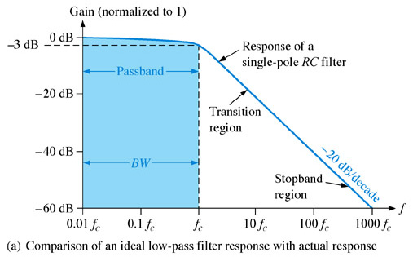
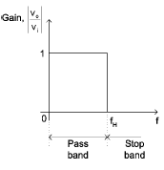
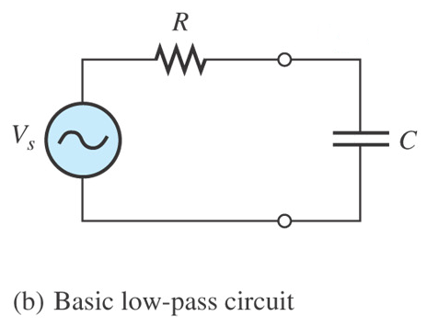
Low Pass Filter Responses
A low-pass filter is a filter that passes frequencies from 0Hz to critical frequency, f_{c} and significantly attenuates all other frequencies.
roll-off rate
V_{o}
Actual response
Ideal response

Slide 8
Passband of a filter is the range of frequencies that are allowed to pass through the filter with minimum attenuation (usually defined as less than -3 dB of attenuation).
Transition region shows the area where the fall-off occurs.
roll-off rate
Stopband is the range of frequencies that have the most attenuation.
Critical frequency, f_{c}, (also called the cutoff frequency) defines the end of the passband and normally specified at the point where the response drops – 3 dB (70.7%) from the passband response.

Slide 9
At low frequencies, X_{C} is very high and the capacitor circuit can be considered as open circuit. Under this condition, V_{o} = V_{in} or A_{V} = 1 (unity).
At very high frequencies, X_{C} is very low and the V_{o} is small as compared with V_{in}. Hence the gain falls and drops off gradually as the frequency is increased.

Slide 10
The bandwidth of an ideal low-pass filter is equal to f_{c}
The critical frequency of a low-pass RC filter occurs when X_{C} = R and can be calculated using the formula below:

Slide 11
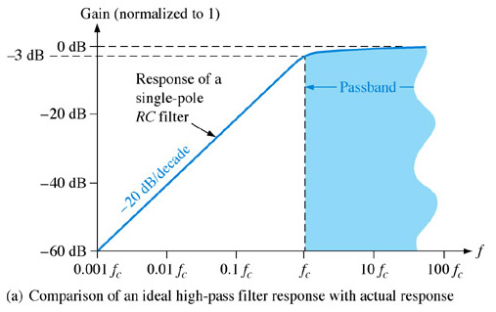
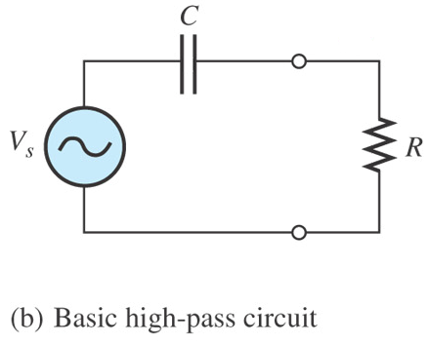
High Pass Filter Response
A high-pass filter is a filter that significantly attenuates or rejects all frequencies below f_{c} and passes all frequencies above f_{c}.
The passband of a high-pass filter is all frequencies above the fc critical frequency.
V_{o}
Actual response
Ideal response

Slide 12
The critical frequency of a high-pass RC filter occurs when
X_{C} = R and can be calculated using the formula below:

Slide 13
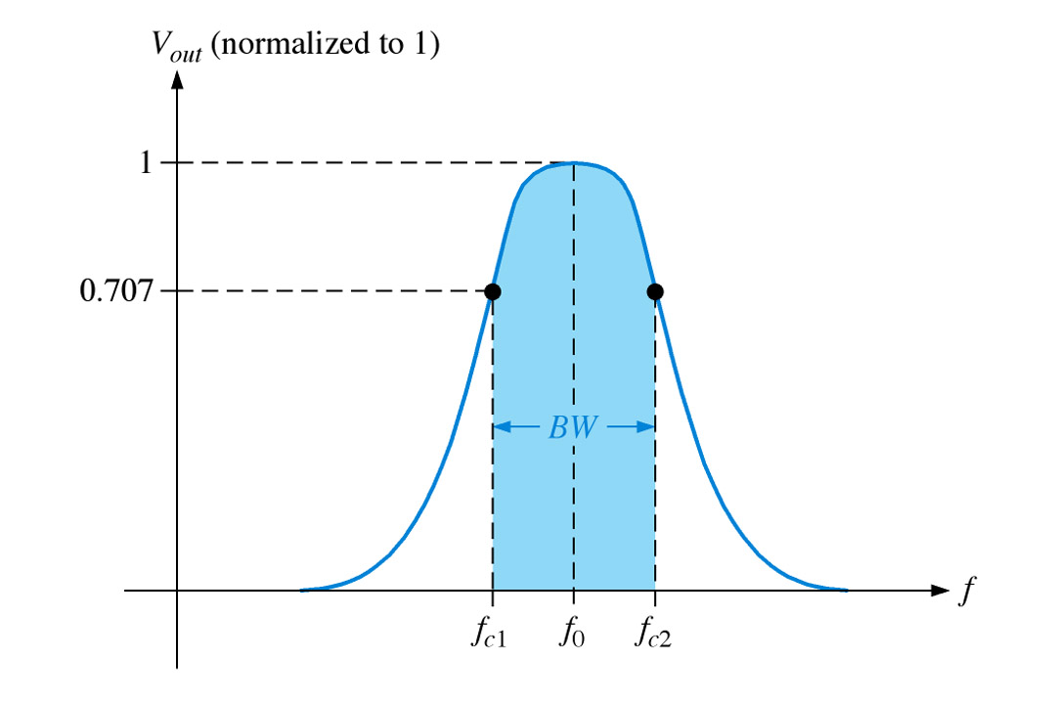
Band Pass Filter Response
A band-pass filter passes all signals lying within a band between a lower-frequency limit and upper-frequency limit and essentially rejects all other frequencies that are outside this specified band.
Actual response
Ideal response

Slide 14
The bandwidth (BW) is defined as the difference between the upper critical frequency (f_{c2}) and the lower critical frequency (f_{c1}).

Slide 15
The frequency about which the pass band is centered is called the center frequency, f_{o} and defined as the geometric mean of the critical frequencies.

Slide 16
The quality factor (Q) of a band-pass filter is the ratio of the center frequency to the bandwidth.
The higher value of Q, the narrower the bandwidth and the better the selectivity for a given value of f_{o.}
(Q>10) as a narrow-band or (Q<10) as a wide-band
The quality factor (Q) can also be expressed in terms of the damping factor (DF) of the filter as :

Slide 17
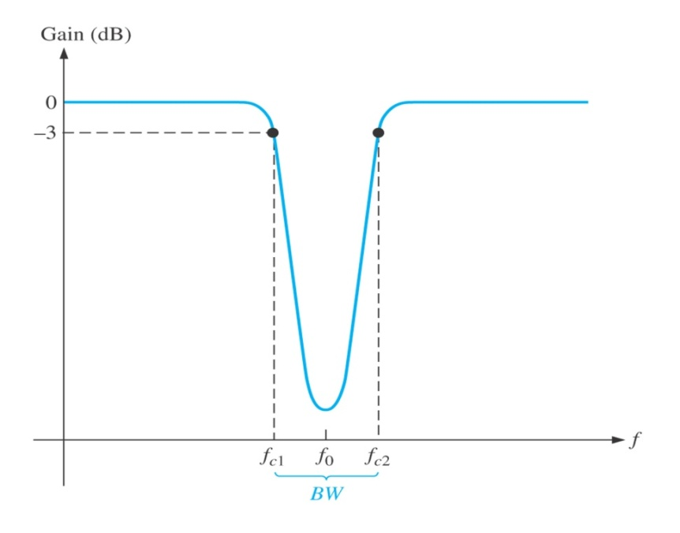
Band Stop Filter Response
Band-stop filter is a filter which its operation is opposite to that of the band-pass filter because the frequencies within the bandwidth are rejected, and the frequencies above f_{c1} and f_{c2} are passed.
Actual response
For the band-stop filter, the bandwidth is a band of frequencies between the 3 dB points, just as in the case of the band-pass filter response.
Ideal response

Slide 18
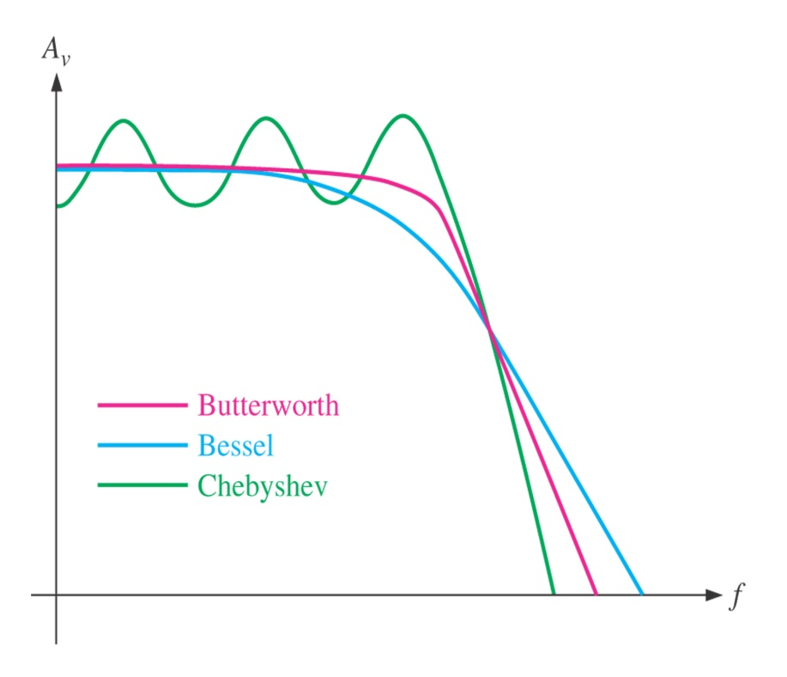
Filter Approximation
There are 3 characteristics of filter response :
i) Butterworth characteristic
ii) Chebyshev characteristic
iii) Bessel characteristic.
Each of the characteristics is identified by the shape of the response curve
Comparative plots of three types of filter response characteristics.

Slide 19

Butterworth Characteristics
Filter response is characterized by flat amplitude response in the passband.
Provides a roll-off rate of -20 dB/decade/pole.
Filters with the Butterworth response are normally used when all frequencies in the passband must have the same gain.
Comparative plots of three types of filter response characteristics.

Slide 20

Chebyshev Characteristics
Filter response is characterized by overshoot or ripples in the passband.
Provides a roll-off rate greater than -20 dB/decade/pole.
Filters with the Chebyshev response can be implemented with fewer poles and less complex circuitry for a given roll-off rate
Comparative plots of three types of filter response characteristics.

Slide 21

Bessel Characteristics
Filter response is characterized by a linear characteristic, meaning that the phase shift increases linearly with
frequency.
Filters with the Bessel response are used for filtering pulse waveforms without distorting the shape of waveform.
Comparative plots of three types of filter response characteristics.

Slide 22
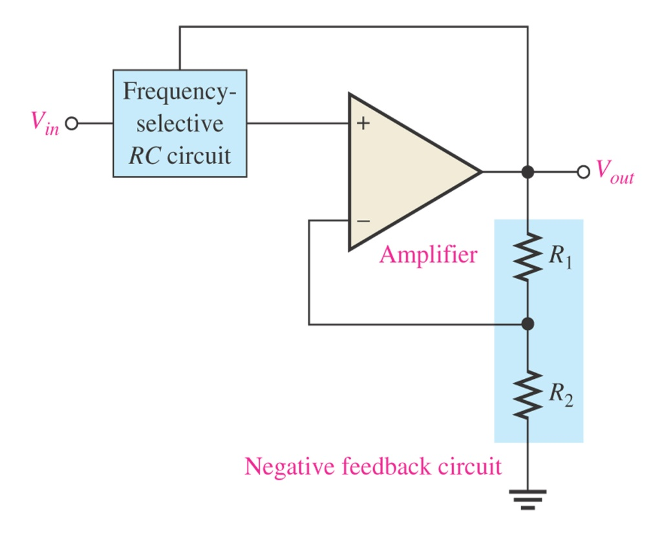
Damping Factor
The damping factor (DF) of an active filter determines which response characteristic the filter exhibits.
This active filter consists of an amplifier, a negative feedback circuit and RC circuit.
The amplifier and feedback are connected in a non-inverting configuration.
DF is determined by the negative feedback and defined as :
General diagram of active filter

Slide 23
The value of DF required to produce a desired response characteristics depends on order (number of poles) of the filter.
A pole (single pole) is simply one resistor and one capacitor.
The more poles filter has, the faster its roll-off rate

Slide 24
For a single-pole (first-order) filter, the critical frequency is :
The above formula can be used for both low-pass and high-pass filters.

Slide 25
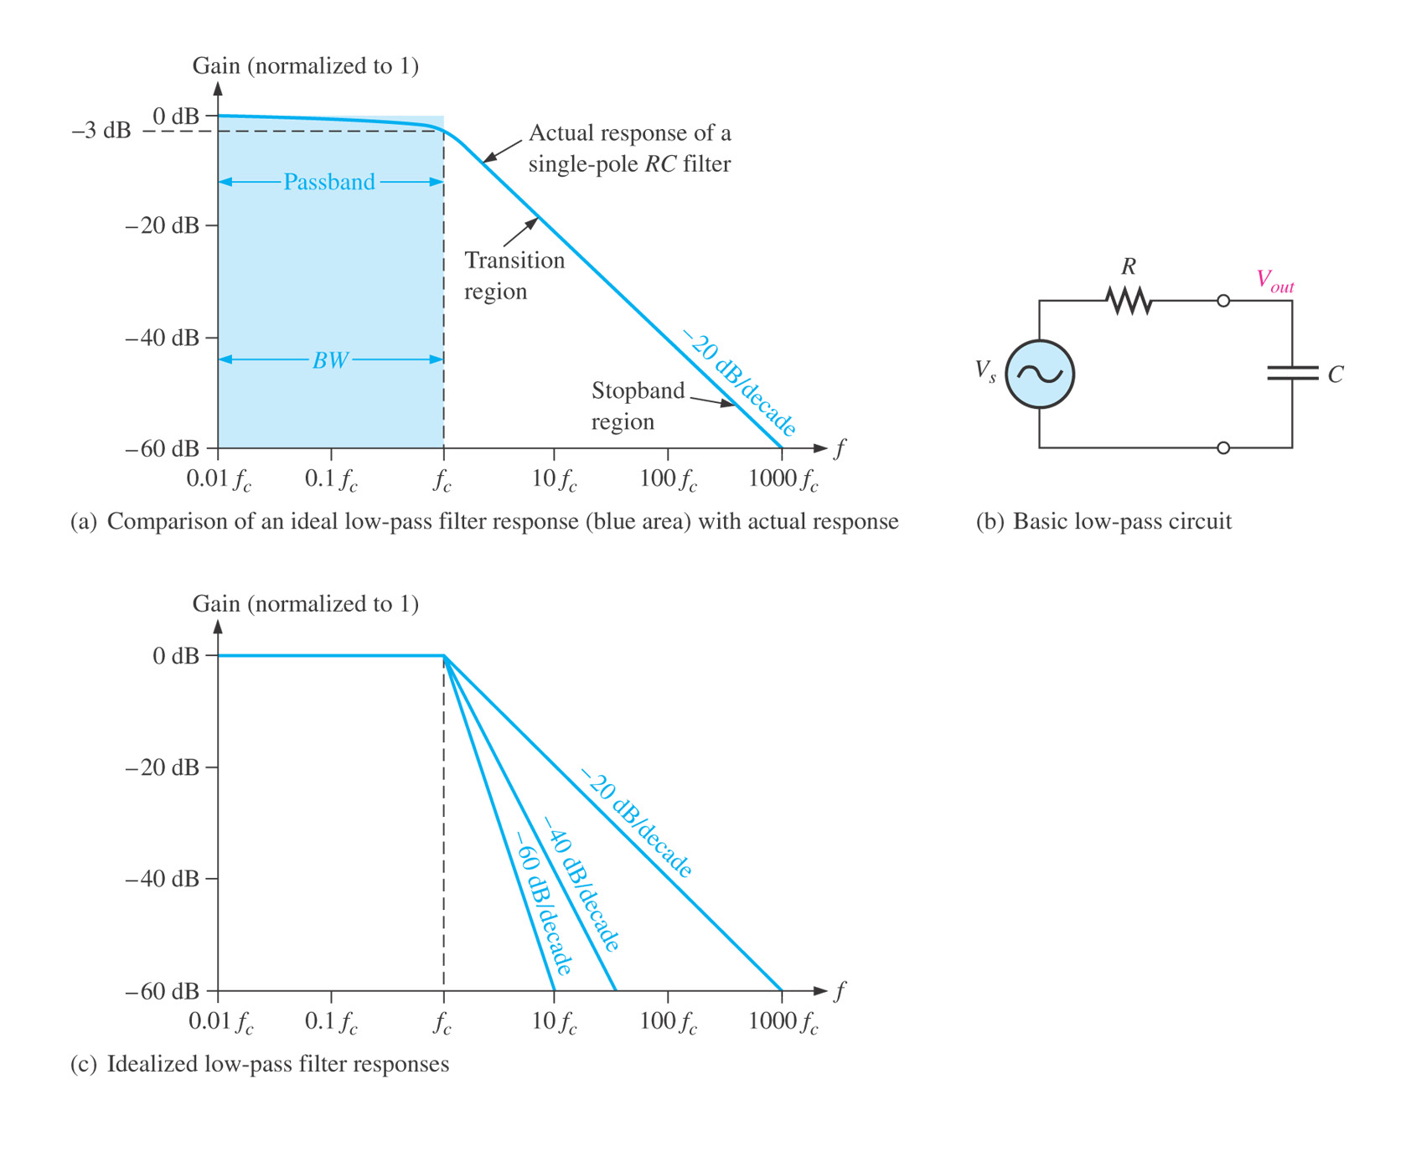
The number of poles determines the roll-off rate of the filter. For example, a Butterworth response produces -20dB/decade/pole.
This means that:
One-pole (first-order) filter has a roll-off of -20 dB/decade
Two-pole (second-order) filter has a roll-off of -40 dB/decade
Three-pole (third-order) filter has a roll-off of -60 dB/decade

Slide 26
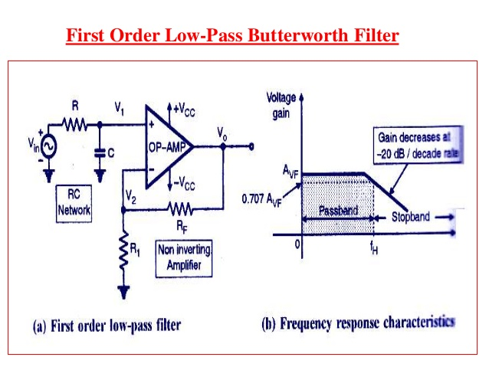
First order lowpass butterworth Filter

Slide 27
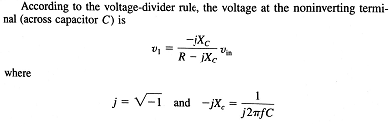
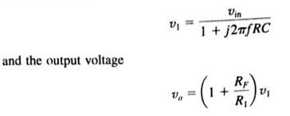

Slide 28
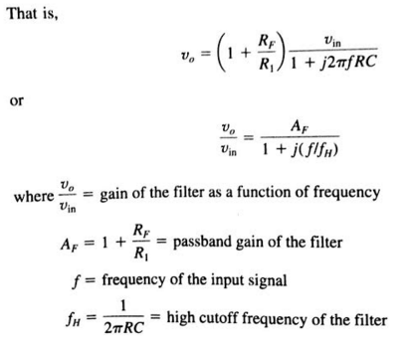

Slide 29
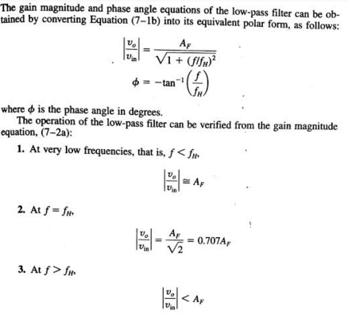

Slide 30
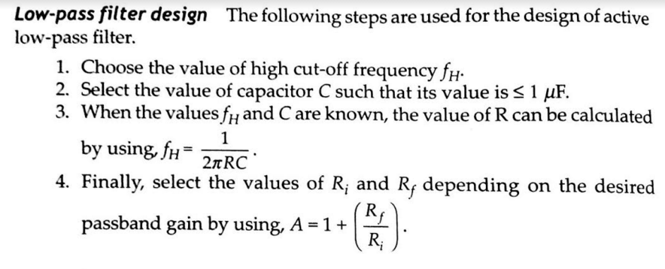
Low pass Filter Design

Slide 31
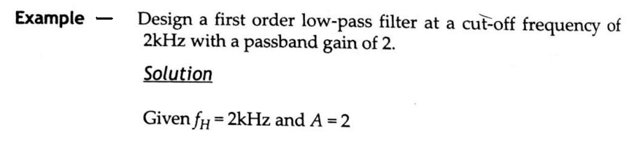
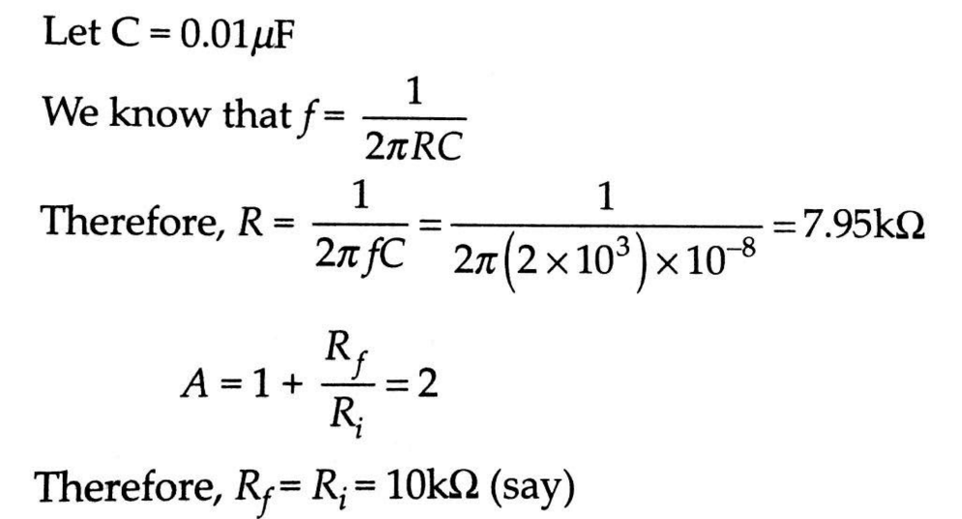

Slide 32
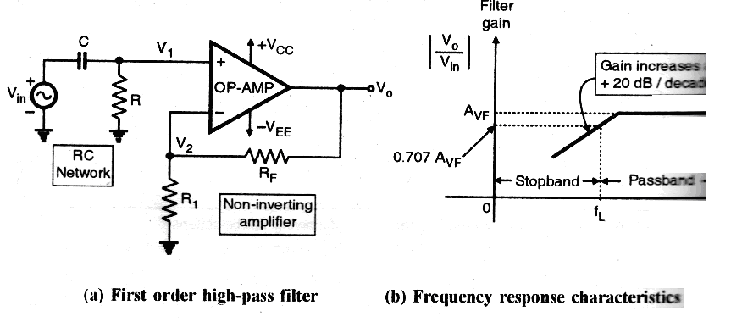
First Order High Pass Filter
f_{L} is shown for HPF
RC components decide the cut off frequency of the HPF where as R_{F} & R₁ decide the closed loop gain.

Slide 33


Expression For The Gain:
Voltage
Output voltage =
Magnitude=
Gain =

Slide 34
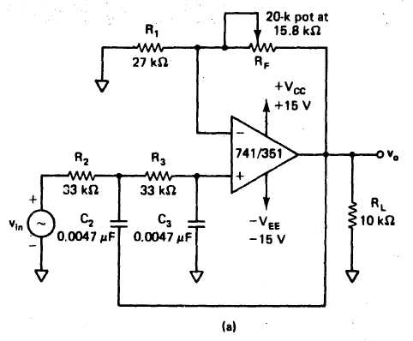
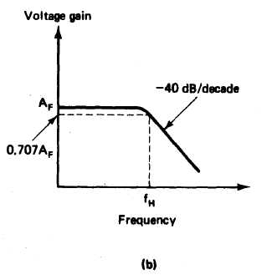
Second-order Low-pass Butterworth Filter
The gain of the second-order filter is set by R₁, and R_{F}, while the high cutoff frequency f_{H} is determined by R₂, C₂, R₃, and C₃, as follows:

Slide 35

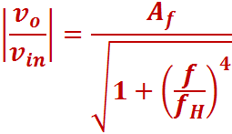
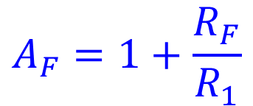
High Cutoff frequency,
A_{F} = 1.586 for 2nd order Butterworth Filter

Slide 36

Second order low pass filter design
1. Choose a value for the high cutoff frequency f_{H}
2. To simplify the design calculations, set
R₂ = R₃ = R and C₂ = C₃ = C.
Then choose a value of C ≤ 1µF
Calculate the value of R using Equation for f_{H}:
Finally, because of the equal resistor (R₂ = R₃) and capacitor (C₂ = C₃) values, the pass band voltage gain A_{F} = (1 + R_{F}/R₁) of the second-order low-pass filter has to be equal to 1.586. That is, R_{F} = 0.586/R₁
This gain is necessary to guarantee Butterworth response. Hence choose a value of R₁ < 100 kΩ and calculate the value of R_{F} .

Slide 37
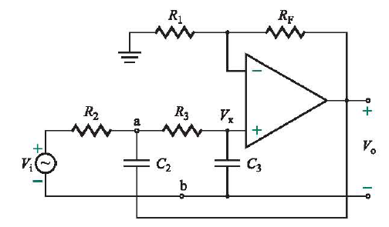
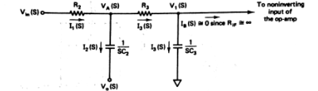
Second- Order Low-Pass Butterworth Filter
S domain transformation

Slide 38
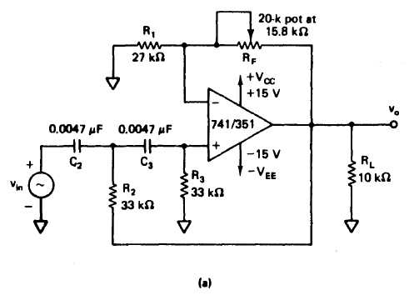
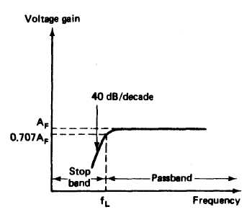
Second-order High-pass Butterworth Filter

Slide 39

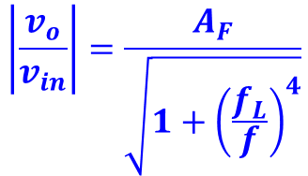
Second-order High-pass Butterworth Filter
As in the case of the first-order filter, a second-order high-pass filter can be formed from a second-order low-pass filter simply by interchanging the frequency determining resistors and capacitors.
A_{F} = 1.586 for 2nd order Butterworth Filter

Slide 40


Band Pass Filter
A bandpass filter has pass band between two cut off frequencies f_{H} and f_{L}. Such that f_{H} > f_{L}.
Any input frequency outside this is attenuated
Two types of band pass filter
1)Wide bandpass whose quality factor Q < 10
2)Narrow bandpass filter whose quality factor Q > 10
Thus Q is measure of selectivity that means if Q is higher then the filer is more selective and its bandwidth is narrow.
The relationship between Q, the 3-dB BW and center frequency f_{C} is given by ,
For wide bandpass filter the center frequency f_{C} can be defined as,

Slide 41
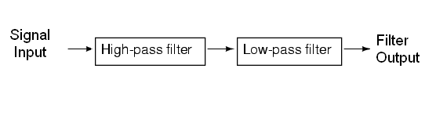
Block Diagram Of Band pass Filter

Slide 42
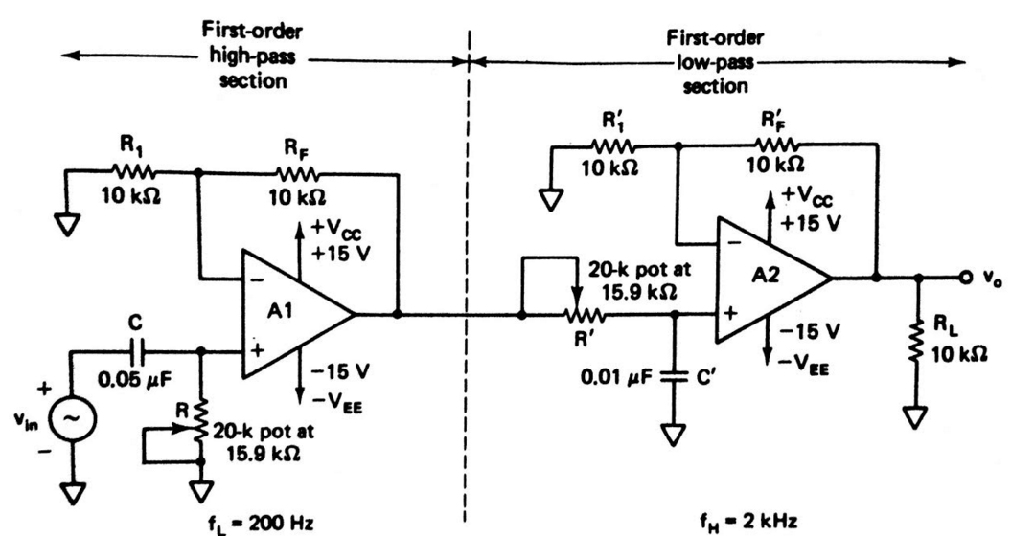

Slide 43
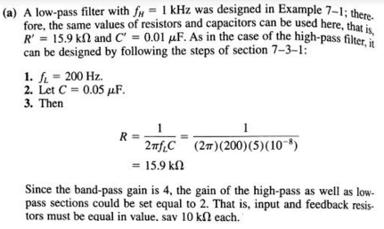
Example 1 :Design a wide bandpass filter with fL=200hz and fH is 1 kHz and passband gain=4. a. Draw the frequency response plot of this filter . B. Calculate the value of Q for filter.

Slide 44
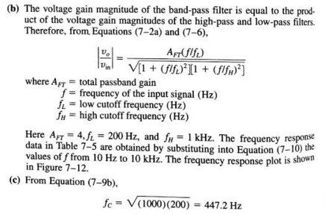


Slide 45
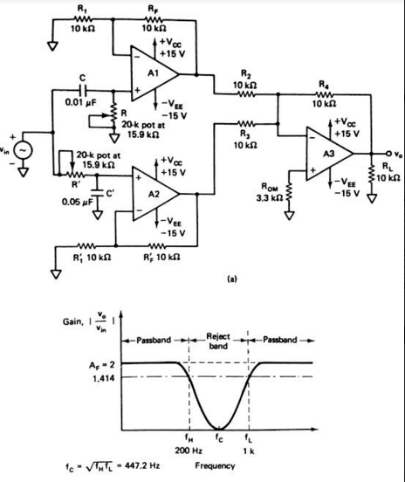
Band stop filter

Slide 46
Band Reject filter
It is also called as bandstop or band elimination filter
In this filter frequencies are attenuated in the stopband while they are passed outside this band
It can be classified as 1)wide band reject 2)narrow band reject
The narrow band reject filter is also known as notch filter which has Q>10 and its bandwidth is much smaller than wideband reject filter
wideband reject filter consist of LPF, HPF and summing amplifier.
To relize this f_{L}of HPL must be greater than f_{H} of LPF and the passband gain of both the filters must be equal

Slide 47
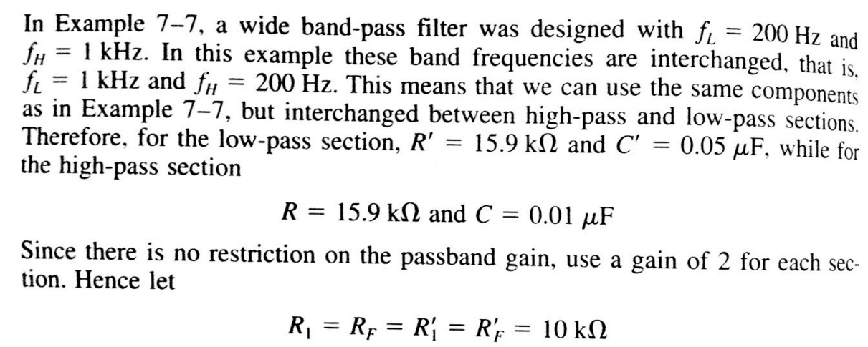
Example: Design the wide band reject filter so that a. f_{L}=1 kHz ,f_{H}=200Hz

Slide 48
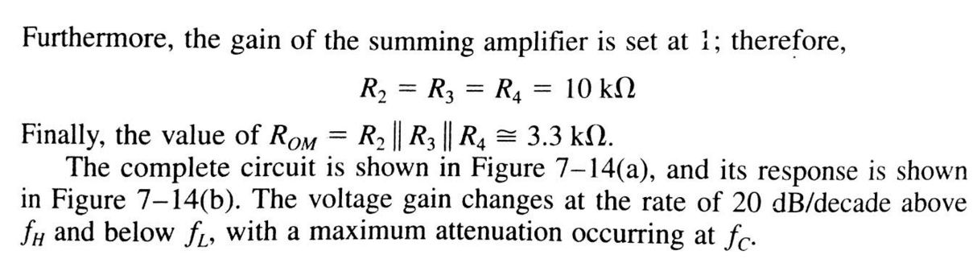

Slide 49
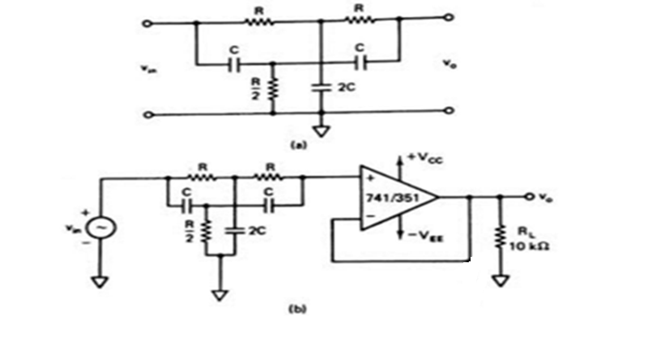
Narrow Band pass filter
It is also known as notch filter , is commonly used for the rejection of single frequency such as 60Hz power line frequency hum. The most commonly used notch filter is the twin-T network .

Slide 50
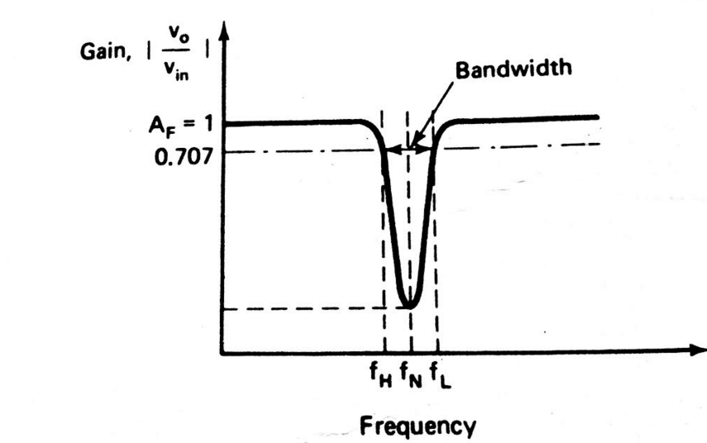
Frequency Response

Slide 51

The notch-out frequency is the frequency _{N} at which the maximum attenuation occurs and it is given by
The passive twin-T network has a relatively low figure of merit Q. The Q of the network can be increased significantly if it is used with the voltage follower.
It is mostly used in communication and biomedical instruments for eliminating undesired frequency

Slide 52
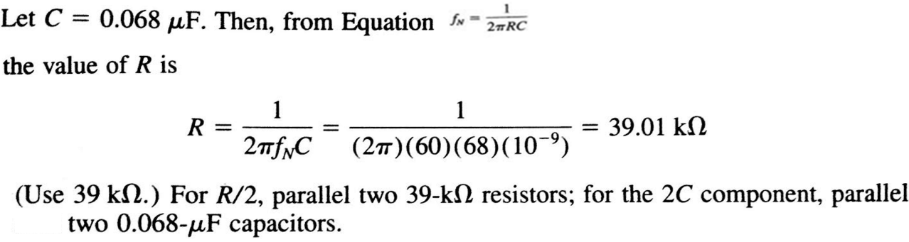
Example : Design a 60 Hz active notch filter

Slide 53
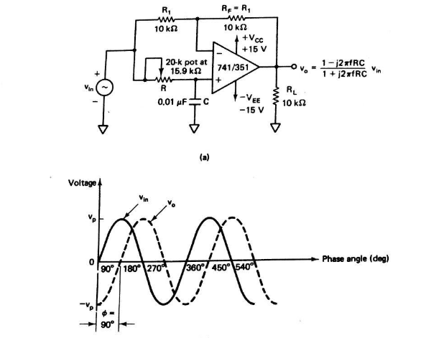
All Pass Filter

Slide 54
ALL PASS FILTER

Slide 55
All Pass Filter
It passes all frequency components of the input signal without attenuation, while providing predictable phase shifts for different frequencies of the input signal.
When signals are transmitted over transmission lines, such as telephone wires, they undergo change in phase.
To compensate for these phase changes, all pass filters are required . It is also known as delay equalizers or phase correctors.

Slide 56




In all pass filter R_{F} = R_{1.} and the output voltage V₀ can be obtained by using the superposition theorem .
Substituting X_{c}=1/ and simplifying above equation we get,
where, f is the input signal frequency
The amplitude of is unity throughout the useful frequency range and the phase shift between V₀ and V_{in} is a function of input frequency f.

Slide 57

The phase angle is given by,
The V₀ lags V_{in} by 90⁰
For fixed values of R and C the phase angle changes from 0 to -180⁰ as the frequency f is varied from zero to infinity.
If the positions of R and C are interchanged, the phase shift between input and output becomes positive i.e V₀ leads V_{in} by 90⁰ .

Slide 58
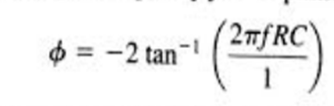
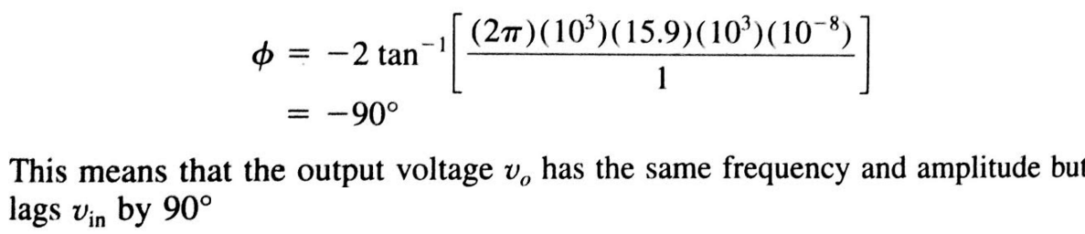
Example: For the Allpass filter find phase angle if the frequency of Vin is 1 kHz.

Slide 59
Reference
1.Ramakant A. Gaikwad, “Op Amps and Linear Integrated Circuits”, Pearson Education 2000.
2.Salivahanan and KanchanaBhaskaran, “Linear Integrated Circuits”, Tata McGraw Hill,India 2008

Slide 60
Thank You.

